Slide 1
The English Colonies

Slide 2
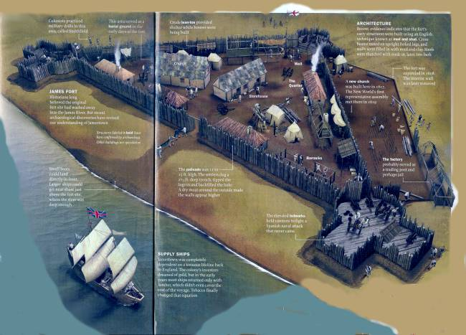
Jamestown (1606)
Founded by the Virginia Company
Joint-Stock company meant to turn immediate profit
Colonists hope to strike gold, strike rich, and go home.
Charter assured colonists “Rights of Englishmen.”
Settlers completely unequipped for their goal
Massive colonist death resulted
John Smith takes control of colony in 1608.
Prevents total collapse, but death tolls continue to be high. Worst is the “Starving Time” of 2009-2010

Slide 3
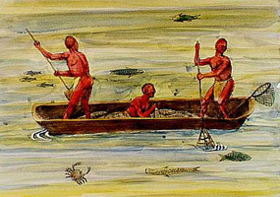
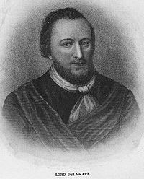
The Colonists & the Powhatan
By 1646, Chesapeake natives forced away from white areas or forced onto what are essentially the first reservations.
By 1685, the Powhatan were considered to be extinct.
A similar pattern repeats itself throughout North America. (See “The Indian’s New World"
Local native tribes of the region loosely united under Chief Powhatan.
Powhatan hoped the English would be an advantage against his enemies.
Very quickly, relations sour as English colonists raid Indian food stores and begin contacting Powhatan’s enemies.
In 1610, Lord De La Ware (aka Delaware) arrives to take control of the colony.
Basically declares war on the Powhatan, using “Irish Tactics” learned from terrorizing the Irish Catholics.
“Irish Tactics” – Burning villages and farmlands
Anglo-Powhatan War lasts until 1614
Eight years of peace, followed by another Anglo-Powhatan war.
English goal: To prevent the Natives “from being any longer a people.

Slide 4
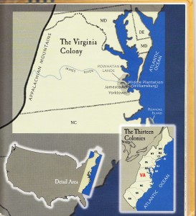
Virginia
By 1612, the colony finally starts making money.
Not from gold: Tobacco!
Introduced to Virginia by John Rolfe
Everyone goes tobacco crazy, causing structural problems:
High level of production causes prices to drop
Land becomes concentrated in the hands of a gentry class, leading to social unrest
New settlers forced further West, further aggravating relations with the Indians
First representative self-government in the colonies: House of Burgesses
This does not thrill the king of England, James I, who does not trust the assembly.
James I continues his ire for the colony, and eventually the Virginia Company goes bankrupt.
In 1624, James I takes direct control of the Virginia Colony.

Slide 5
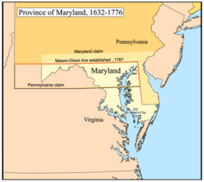
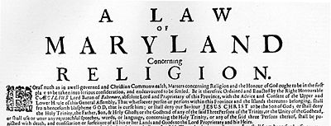
Maryland
As Catholics become the minority, frustration and disorder grows.
In 1649, the Act of Tolerance is passed.
Tolerance only extends to Christian faiths
Non-Christians still subject to death penalty
Even as a minority, Maryland existed as large haven for English Catholics.
Fourth English Colony. Founded 1634
Founded by Lord Baltimore, prominent English Catholic
Goal was to provide a safe haven for Catholics oppressed in England
Like Virginia, based on Plantation economy.
Initially, a few of Lord Baltimore’s family controlled vast, feudal-like estates
People did not want to risk travel to work on an estate
First imported Indentured Servants, then eventually to African slaves.
Eventually, small Protestant freeholders emigrate and agitate against Catholic gentry.

Slide 6
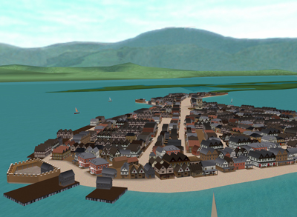
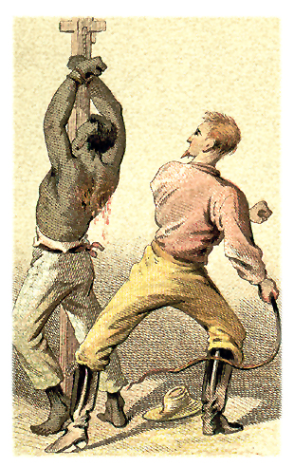
West Indies
In the 1600s, England continues to put pressure on Spain
By 1655, England takes control of Jamaica
Economy of the West Indies dependant on Sugar Plantations.
Required more labor than tobacco at every step
More land required
More labor to plant and harvest
More difficult refining process
Only the rich could afford to “get into the game,” and only then by heavily importing slaves
Slaves eventually outnumber whites 4:1!
Sugar Plantations eventually replace almost all other labor
Requires almost total import of food, tools, and goods
Workers displaced by plantations move to southern North American colonies
Brought with them the exceptionally harsh slave code
“Barbados Slave Code” becomes legal model for other colonies
Computer model of colonial Port Royal, Jamaica. Created by UCLA’s Experimental Technologies Center.
Needless to say, draconian slave laws were enacted by whites terrified of rebellion.

Slide 7
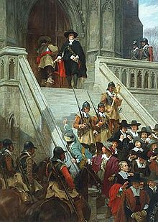
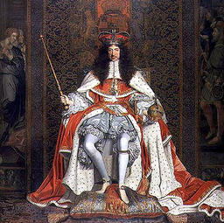
Carolinas
Colonization halts during the English Interregnum during the mid-1600s.
When Parliament restored the King in 1660, colonization begins anew.
King Charles II
Oliver Cromwell & Friends

Slide 8
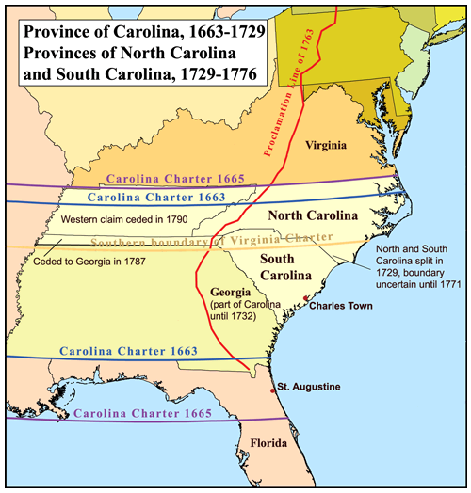
Carolinas
King Charles gives eight of his friends a colony
Business Plan:
Provide supplies to the West Indies colonies.
Becomes economically tied to West Indies
Slave Trade
Indians to West Indies
Black slaves from W. Indies
Import Slave Code

Slide 9
Carolinas
Settlers and Indian allies turn on each other.
Savannah Indians all but wiped out by 1710
Rice becomes main export.
Import slaves from Africa for their experience

Slide 10
Carolinas
Spanish Florida to the south alarmed by growth of Carolinas
Indian allies of both sides engage in proxy conflicts
Eventually leads to several Anglo-Spanish wars

Slide 11
Carolinas
To the north, there are already many displaced “squatters” from Virginia before the charter is given.
Did not cooperate with new plantation barons
Became allies of pirates
Eventually leads to division into two colonies

Slide 12
Georgia
Actually not a colony at the period we have under discussion.
Founded as a prison
Georgia would not be founded until 1733
Buffer between Colonies and Spain
Imperial Soldiers
Money

Slide 13
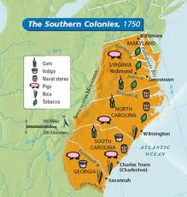
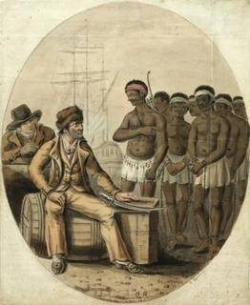
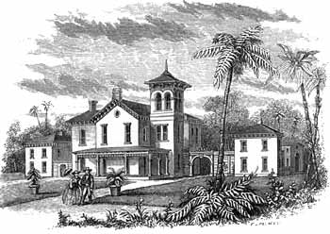
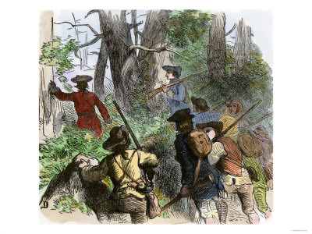
The Agricultural South
The colonies of the South shared a great number of characteristics.
Plantation Cash-Crop Economy
Reliance on Slave Labor
Politics dominated by landed elites
Expansionist
(fueled by disenfranchised)
Primarily Rural, Few Cities
Religiously Tolerant (By Comparison)

